Slide 1
ANALYSIS OF USA’S DATA
By Abhinav Kumar

Slide 2
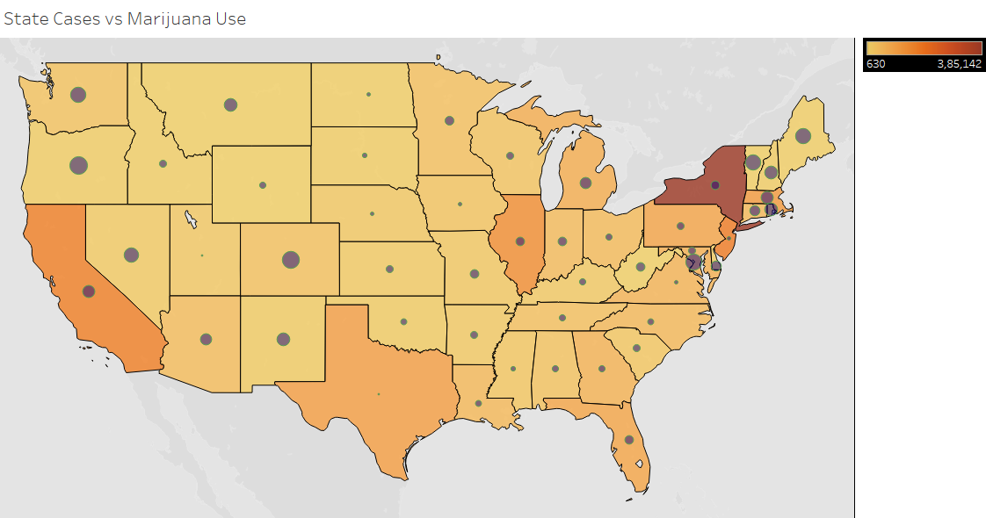

Slide 3


Slide 4
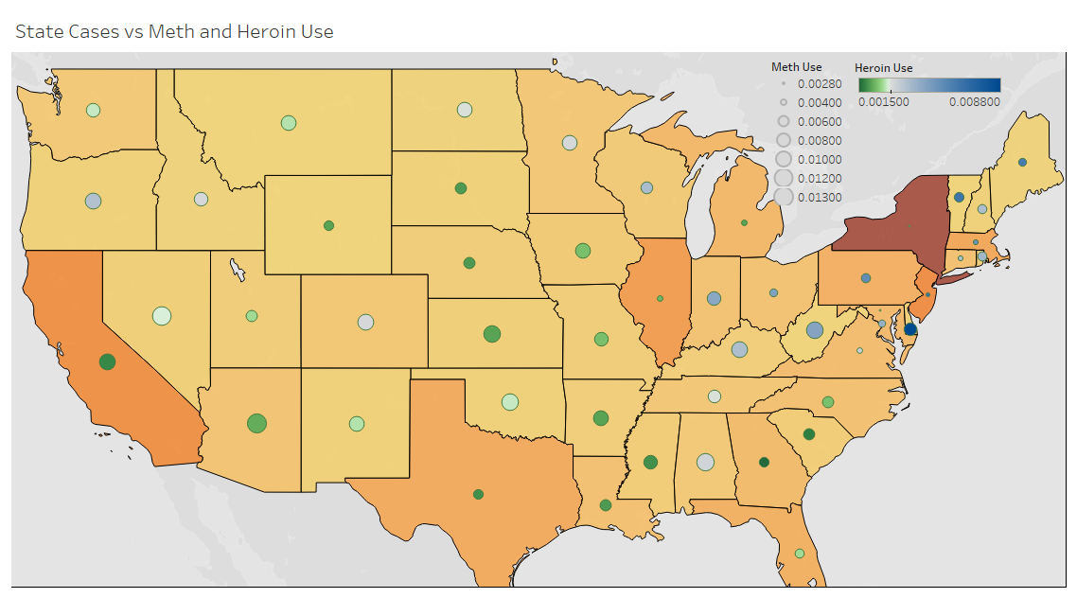

Slide 5
There appears to be no relation between cases and the use of any type of drug. Analysis could be done with respect to mortality ratio or recovery but since all states don’t have precise data available, it is avoided.

Slide 6
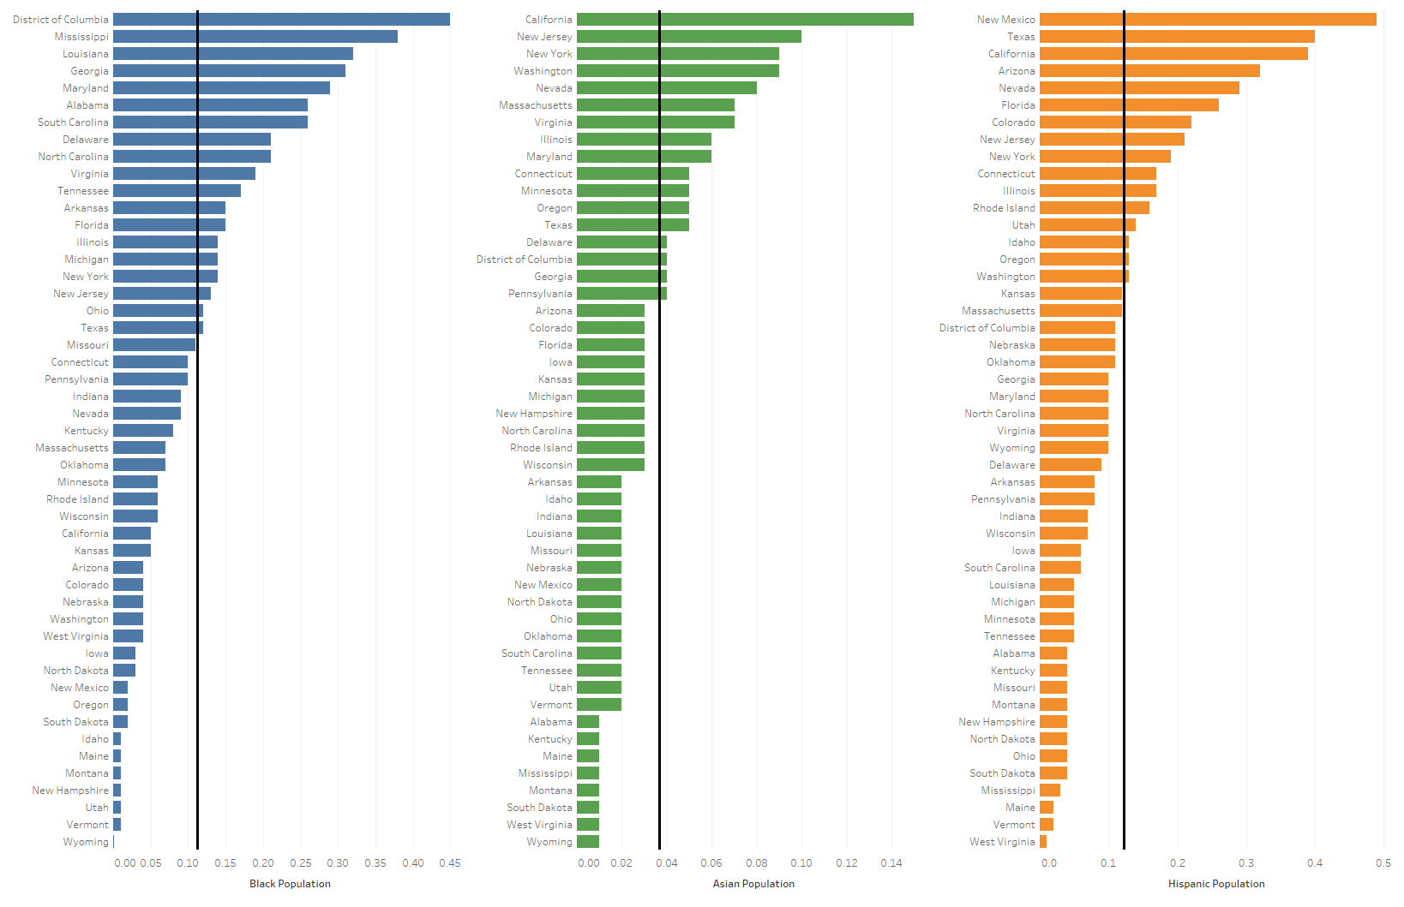

Slide 7
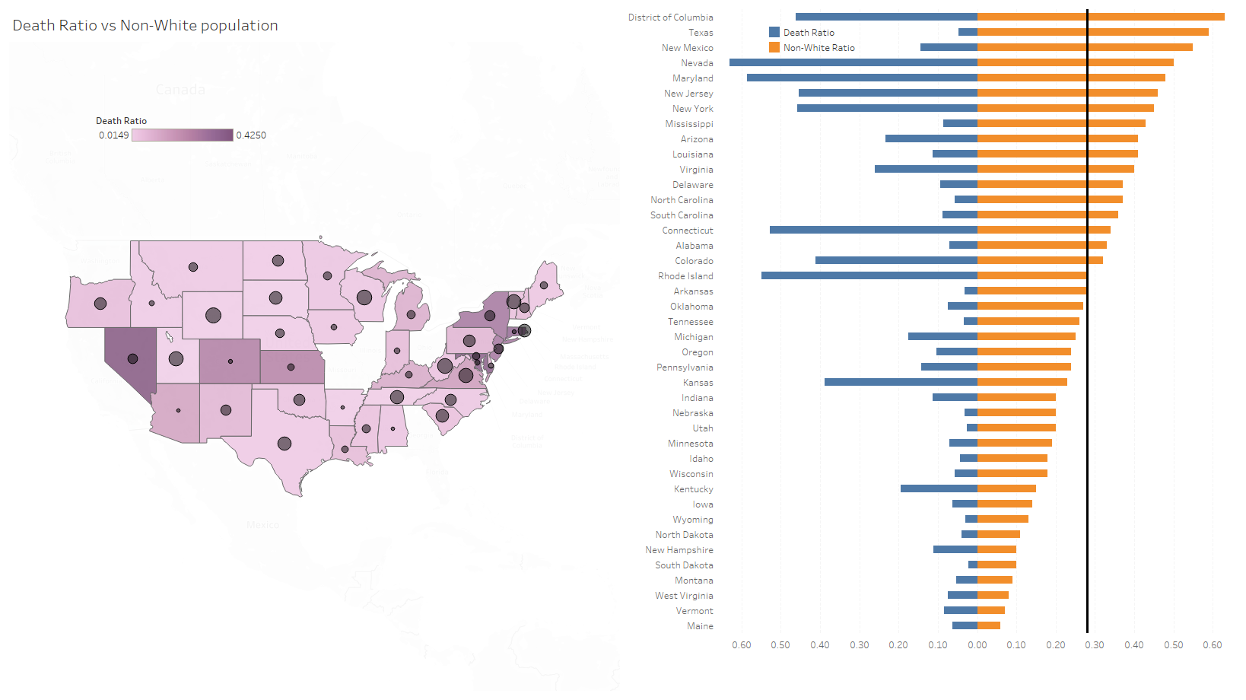

Slide 8
The average death ratio in states with non-white population greater than the average of 28% is 0.1884.
The average death ratio in states with non-white population less than the average is 0.0611.
Death Ratio = Deaths/(Deaths + Recovered)
Non-White Pop. = Asian + Black + Hispanic + Others

Slide 9
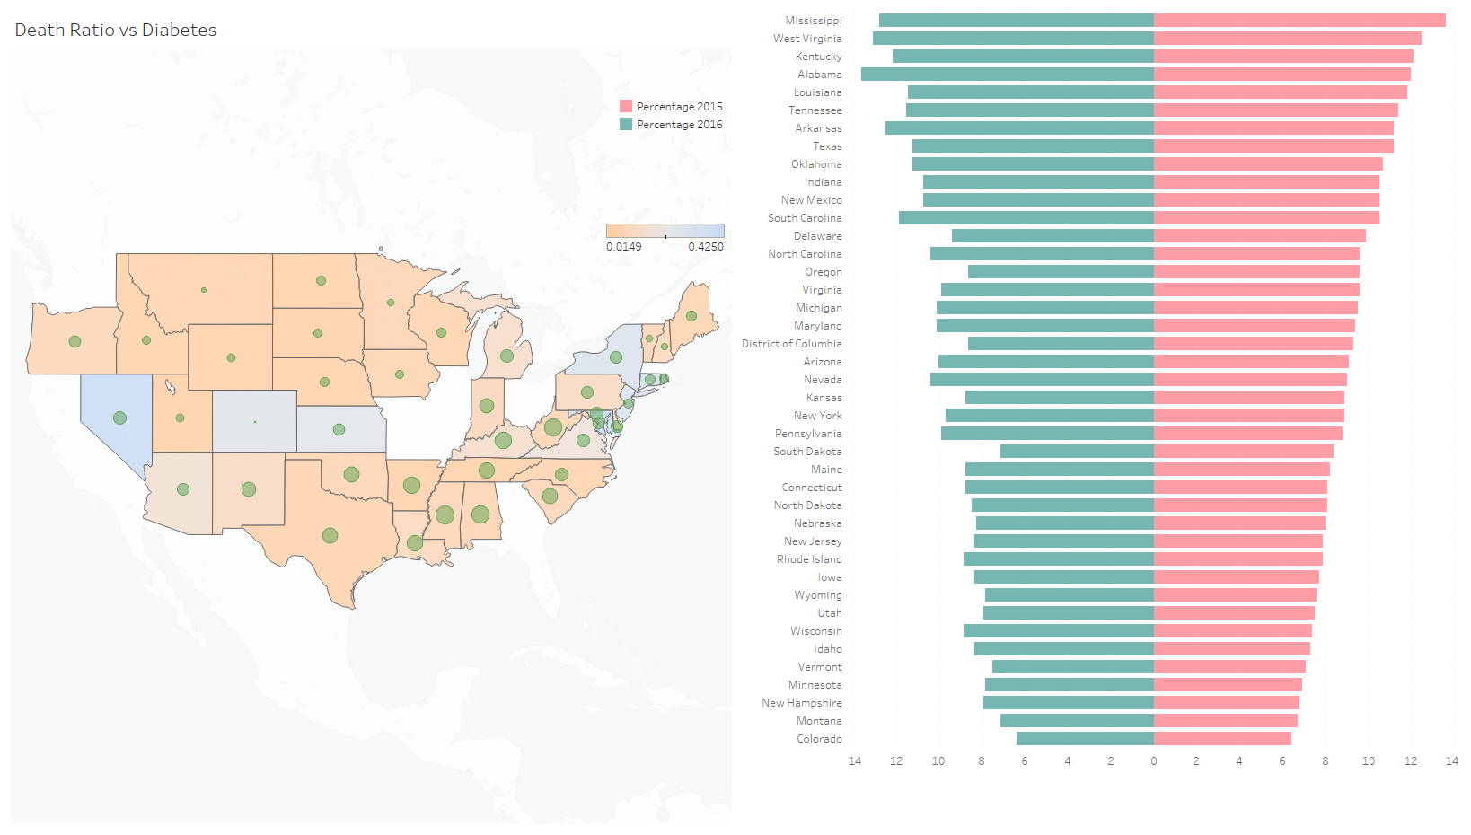

Slide 10
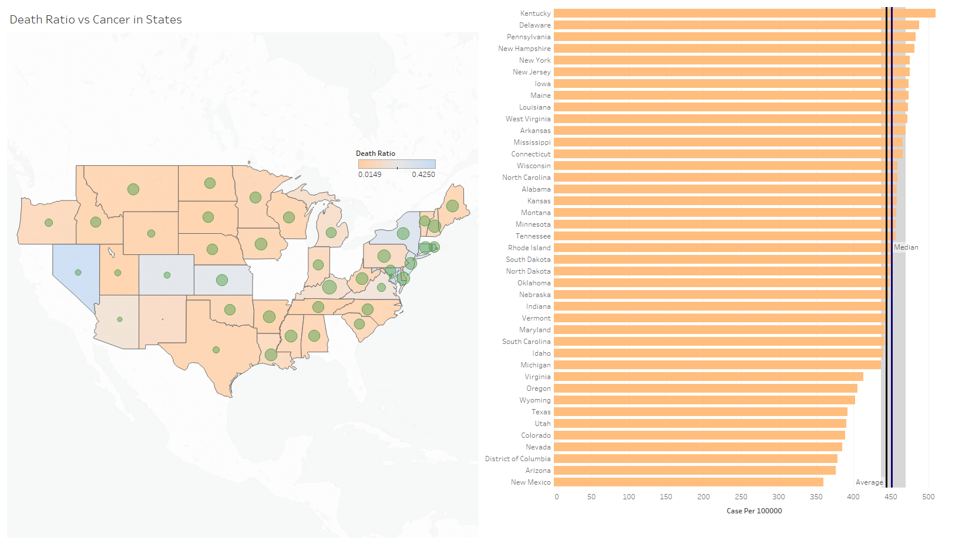

Slide 11
The number of cancer cases per 100,000 people is pretty consistent and seems to have no effect on the death ratio. One would expect a state having higher number of cancer patients to have a higher death ratio since there is increased susceptibility, but that doesn’t seem to be the case.
Diabetes too, doesn’t make any difference in the death ratio of states.

Slide 12
GRAPH VIEW
https://public.tableau.com/profile/abhinavkumar#!/vizhome/CoronavirusUSA_15927506257840/Co-morbidityRaceandDrugs?publish=yes

